Slide 1
計算機概論實習
Week11(2020/11/17)
遞迴函式(Recursive Function)
Lab: EC 118
助教:
陳作源 russchen.cs08g@nctu.edu.tw
陳彥銨 my91015.cs08g@nctu.edu.tw
鄭智仁 king601012003.cs08g@nctu.edu.tw

Slide 2

Loop
$$int printTo100(int num)$$ $\{$ $for \left(int i=num;i<100 ;i++\right)$
$\{$ printf(“%d\n”,i);
$\}$
$$\}$$

Slide 3
Recursive function
Definition (wiki)：
one or more base cases, meaning input(s) for which the function produces a result trivially (without recurring),
one or more recursive cases, meaning input(s) for which the program recurs (calls itself).

Slide 4
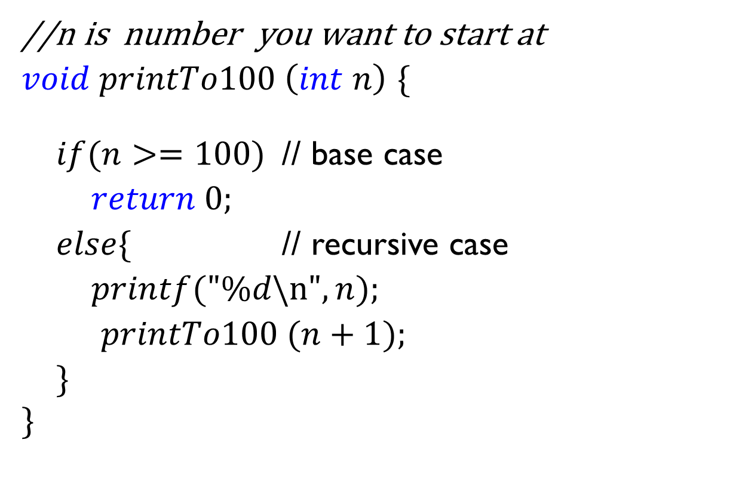
Recursive function
//n is number you want to start at
$void printTo100 \left(int n\right)$ $\{$ $if(n>=100)$ // base case
$return 0;$
$else\{$ // recursive case
$printf("\%d\backslash n",n);$
$printTo100 (n+1);$
$\}$
$$\}$$

Slide 5



Example１： Summation in recursion
$$int SUM\left(int a[],int n\right)\{$$
$if \left(n==1\right)$
$return a[n −1];$
$else$ $$return a\left[n −1\right]+SUM(a, n−1); \\ \}$$
8+13=21
5+7=13
3+4=7
2+2=4
1+1=2
1
Notes:
,

Slide 6

Example2：Fibonacci sequence
$$int Fibonacci \left(int n\right)\{$$
if (n == 0)
return 0;
$else if \left(n==1\right)$
$return 1;$
$else$ $$return Fibonacci\left(n −1\right)+Fibonacci\left(n −2\right); \\ \}$$

Slide 7

Example2：Fibonacci sequence
$$int Fibonacci \left(int n\right)\{$$
if (n == 0)
return 0;
$else if \left(n==1\right)$
$return 1;$
$else$ $$return Fibonacci\left(n −1\right)+Fibonacci\left(n −2\right); \\ \}$$

Slide 8
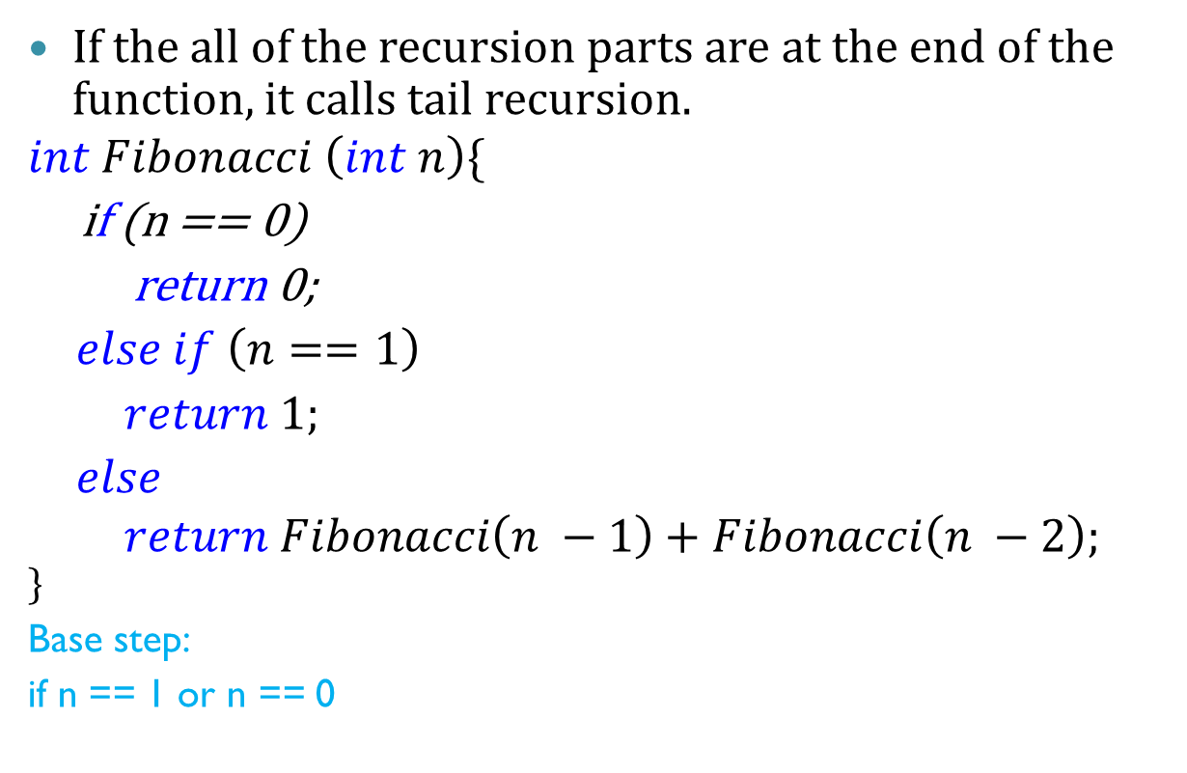
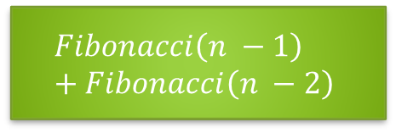
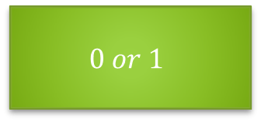
Tail Recursion:
If the all of the recursion parts are at the end of the function, it calls tail recursion.
$$int Fibonacci \left(int n\right)\{$$
if (n == 0)
return 0;
$else if \left(n==1\right)$
$return 1;$
$else$ $$return Fibonacci\left(n −1\right)+Fibonacci\left(n −2\right); \\ \}$$
Base step:
if n == 1 or n == 0
$$0 or 1$$
Function call
Recursive step:
In the end of the function
$$Fibonacci\left(n −1\right)+Fibonacci\left(n −2\right)$$

Slide 9
Benefit of tail recursion:
Tail recursion can be easier rewriting to the loop, because it would not jump to other part and come back later.
Can’t rewrite to loop：
Next function call
Recursion part
Function call
Recursion part
Other function part

Slide 10
Exercise: binary search
Given a sorted array which has N elements.
We want to search an element x whether it is in this array or not.
We need to spend n times at most to search it sequentially.
But using binary search, we only need spend log2(n) time to search.

Slide 11
Exercise: binary search
Method :
find the middle point of the array
Compare the value of middle point and the number you look for
If the value of middle point larger than the number, check the left part by recursion.
If the value of middle point smaller than the number, check the right part by recursion.
Keep doing until you find the number or no element in this part.

Slide 12
Exercise: binary search

Slide 13
Exercise: binary search
//arr is the array you need to search , start is the starting index, end is the ending index, num is the number we want to find
The return value is the index of the array if you find the number, or return -1.
Int binary_search(int arr[], int start, int end, int num):
int middle = (start + end) / 2;
printf(“the value of the middle point is %d”, arr[middle]);

Slide 14
Exercise: binary search
Input :
Array size N, and it is less than 10
a sorted array
The number we want
Output:
print “The number is at the index” and the index of the array.
Print “Could not find the number” if the number is not exist in the array.

